Slide 1

Life and Breath:
Unequal health impacts from air pollution in Minnesota
MPHA presentation
May 12, 2022
Kathy Raleigh, MDH Principal Epidemiologist
David Bael, MPCA Economic Policy Analyst

Slide 2
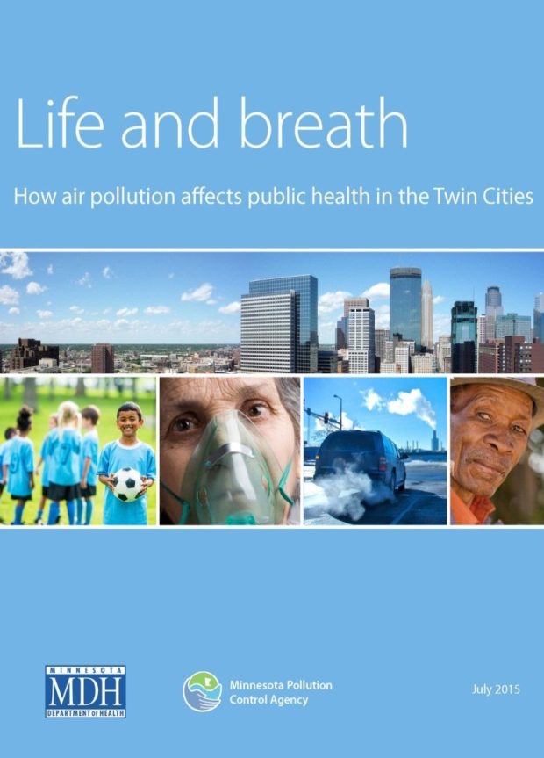
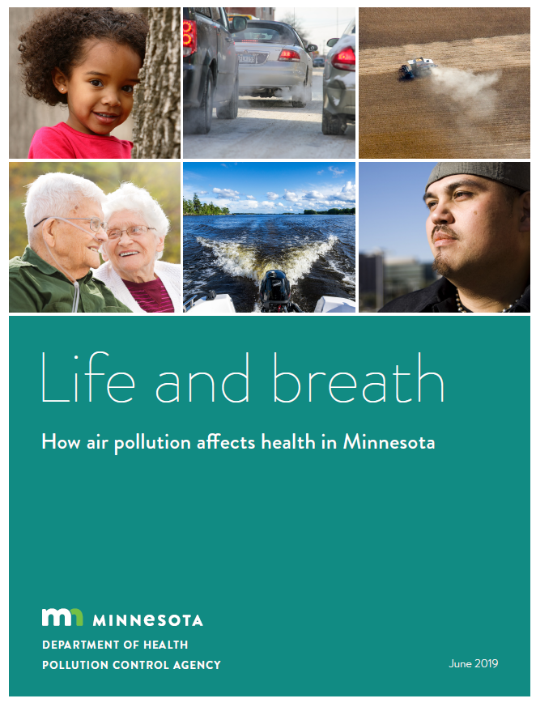
Minnesota Air Quality and Health
MPCA/MDH collaboration to understand and address role of air quality and health
  Air Quality and Respiratory Health Initiative: Goals to use data to inform communities about air quality and health
  MPCA generates air quality monitoring and modeling data, estimates risks to inform actions
  MDH conducts disease surveillance to inform disease prevention actions, including data on social, behavioral and environmental risks
Notes:
Today we will be presenting the recent release of two new reports/data briefs that look at the impacts of air quality and health
This work is the outgrowth of a broader collaboration on an interagency joint initiative (funded by the legislature beginning in 2013)..... bridging data and expertise on this intersection between air and health.
The reports respond to longstanding community and policy-maker concerns
Air pollution and environmental injustice in urban areas
Health inequities related to structural racism and other social determinants of health
Outcomes from the previous two reports:
The state’s Clean Cars rule means more electric vehicles and less exhaust fumes,
and funds from a federal pollution settlement with Volkswagen are being used to build car charging stations and electrify school bus fleets

Slide 3
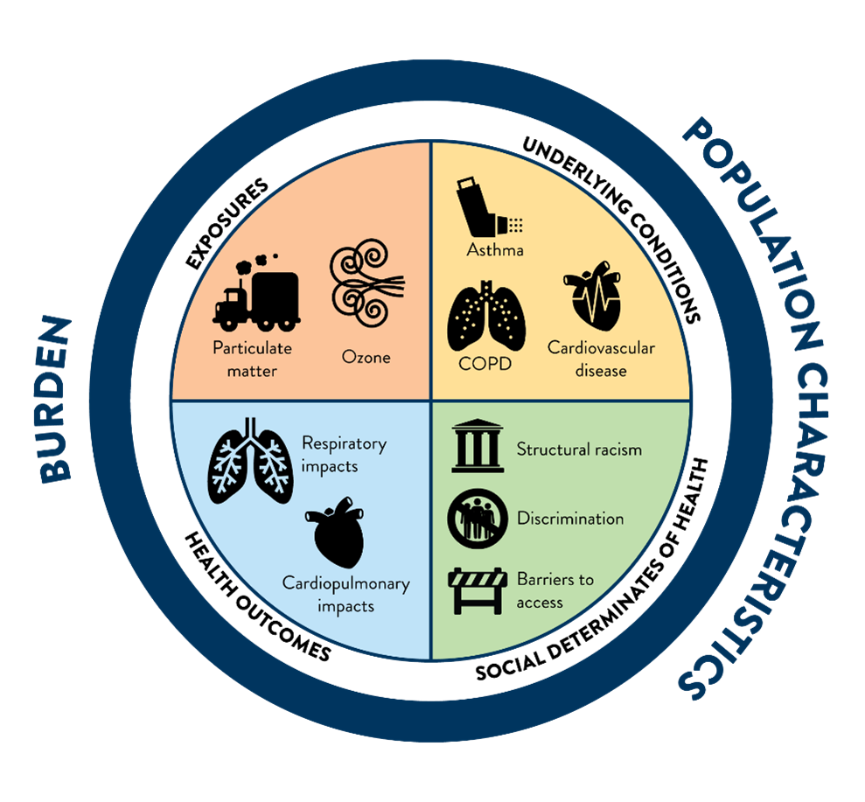
Air & health in Minnesota
Health impacts of air pollution are not evenly distributed
MN has generally good air quality and meets federal standards, but even low and moderate levels of air pollution can contribute to serious illness and death.
Health effects are especially felt in communities already affected by health inequities and over-burdened with other social and environmental stressors.
Notes:
Air pollution is associated with a variety of harmful respiratory and cardiovascular effects, including asthma, pneumonia, bronchitis, and heart attacks. The severity of these effects varies depending on the type of the pollutant, level of exposure, and individual susceptibility.

Slide 4
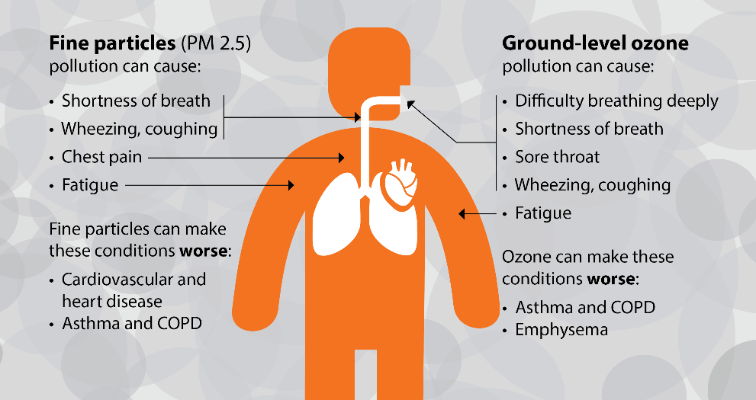
PM_{2.5} and ozone health impacts
Notes:
The World Health Organization estimates that globally outdoor air pollution kills 4.2 million people annually.
PM_{2.5} is a mixture of small particles and liquid droplets smaller than 2.5 microns in diameter. PM_{2.5} is released when coal, gasoline, diesel fuels, wood and other fuels are burned. PM_{2.5} is also created by chemical reactions between other pollutants in the air. PM_{2.5} is released by tobacco smoke and home heating sources, such as wood burning stoves, fireplaces and wildfires
Ground-level ozone is created through a series of reactions between nitrogen oxides (NOx) and volatile organic compounds (VOCs) mixing in the presence of heat and sunlight On hot, sunny summer days, however, ozone concentrations can rise to unhealthy levels.
Sources of pollutants that form ozone include gasoline and diesel vehicles, construction equipment, and electric utilities. Additionally, paints, solvents, and glues/adhesives contain chemicals that may form ozone.

Slide 5
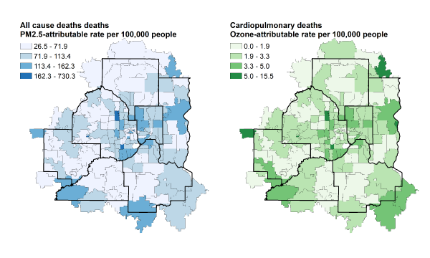
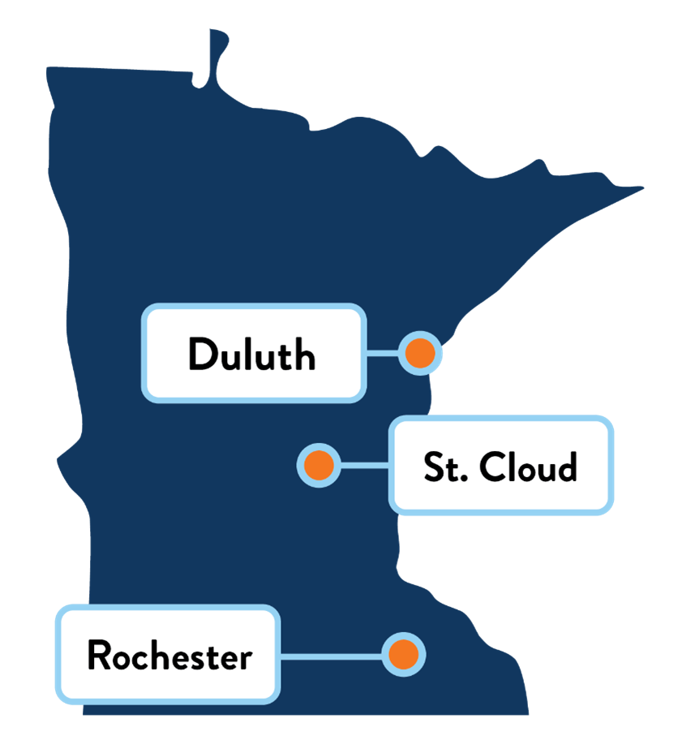
Project goals
Demonstrate magnitude of air pollution’s contribution to serious cardio-pulmonary hospitalizations and premature deaths
  Twin Cities Metro 7-county region zip codes
  Greater MN largest cities
Describe disparate impacts across zip codes and regional patterns in over-burdened and disadvantaged communities
Quantify health benefits of reducing pollution by 10%
Notes:
The overall goals of these analyses were to describe the impact on communities and add to the body of evidence related to the experience of at-risk populations.
These data briefs allow us to look at trends over time building on our work from the first reports, and we also incorporate a new analysis that provides a closer examination of the impacts of AP in greater MN cities
As air pollution poses a persistent PH threat .... we have expanded the work to include an equity analysis for non fatal heart and lung impacts, additionally examining the geographical impact for:
BIPOC residents, people living in poverty, with a disability, or without health insurance
(Ecological study geographic level analysis by zip code)

Slide 6
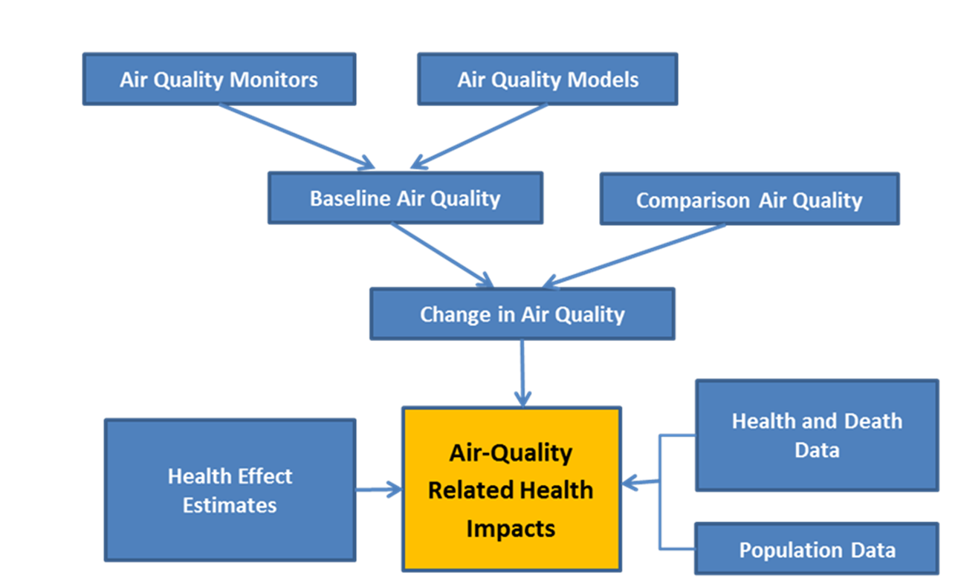
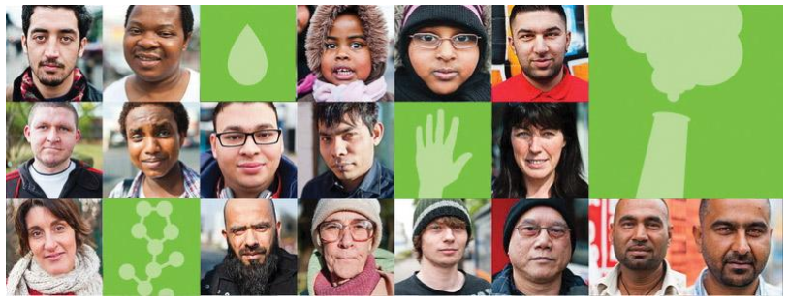
Air and health
How can health impacts of air pollution be counted?
Epidemiological studies measure the relationships between pollutant concentrations and health.
From these relationships, we can estimate the fraction of adverse health impacts that may be attributed to air pollution.
Notes:
Landmark national studies that follow individuals over time and gain insight on the dose-response impact (or what we call the effect estimate)

Slide 7

Project methods and data
Method: EPA impact assessment model (BenMAP)
Applies standard “concentration-response” relationship to estimate population health impacts attributable to local air pollution
Data inputs:
Air pollution modelled data: fused air quality surface using downscaling (US EPA, 2015)
  Annual average PM_{2.5} (daily 24-hour average)
  Seasonal average ozone (8-hour maximum)
Hospitalization, ED visit data (MN Hospital Association, 2013-2017); Death data (MDH Office of Vital Records (2013-2017))
Equity factors: poverty rate, residential BIPOC population, uninsured, disability status (US Census 2013-2017)
Notes:
Our purpose is to show the general magnitude of the problem of air pollution and health. So, these data briefs are Health Impact Assessments where we used seminal peer reviewed, established studies alongside local data for a population based ecological framework
(so.....again these are models that are not meant to give precise estimates of the health burden of air pollution- but the overall magnitude of the impacts

Slide 8
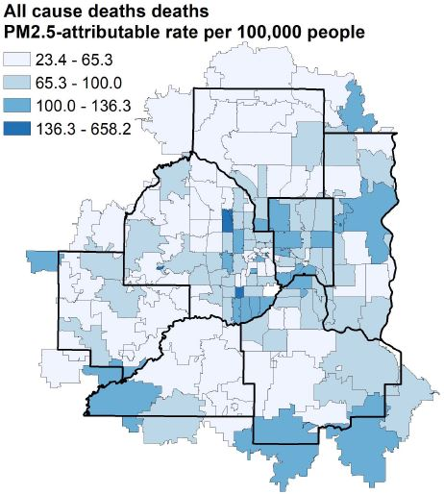
Overall findings
Air pollution contribution to premature mortality:
10% of deaths in the Twin Cities metro area (about 1,600 deaths)
9% of deaths in three Greater MN cities (about 280 deaths)
Disproportionate impacts across marginalized communities
Persistent and consistent with prior work
Underlying chronic health inequities are key driver
Inequities faced by communities with more BIPOC residents, more people living in poverty, with a disability, or without health insurance are critical area for action

Slide 9
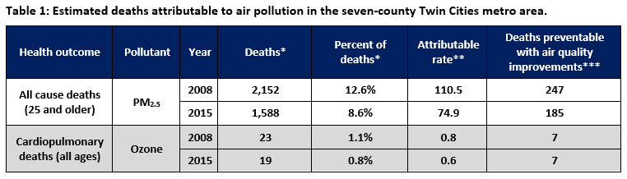
Findings: Air pollution and early deaths
Notes:
Between 2008 and 2015, fine particles (PM_{2.5}) pollution improved by 30% and ozone pollution improved by nearly 10% in the metro. We know that even low levels of air pollution can adversely affect health and more for people who already have lung and heart conditions.
In 2015, we estimated that air pollution played a role in 10% of all deaths — about 1,600 — in the Twin Cities metro area. For comparison, Alzheimer’s disease caused a similar number of deaths in 2015 — about 1,700 — and was the sixth leading cause of death in Minnesota.

Slide 10
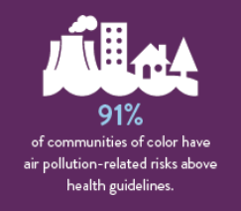
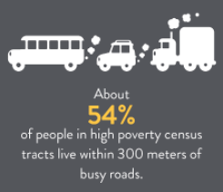
Social determinants of health
Structural inequities and environmental injustice
4 Social indicators evaluated
  BIPOC populations
  Poverty level
  Un-insurance status
  Disability status
Notes:
Environmental justice involves working to ensure all Minnesotans not only have equal protection from environmental harms, but also have their voice represented in decision making with respect to the development, implementation, and enforcement of environmental laws, regulations, and policies.
Environmental justice is a key component to advancing health equity. Thus, the social determinants of health that are related to health equity are also important for understanding and advancing environmental justice.
Due to structural inequities from environmental injustice (e.g., institutional systems and policies), people living near high-traffic roads and heavy industry can experience heavy local source air pollution exposures. Communities that live, work, and gather in less-polluted areas often fare better. This unequal air pollution burden, together with higher underlying rates of lung, heart, and other health conditions can lead to disparate health outcomes for BIPOC communities, people living in poverty or with a disability and individuals without health insurance.

Slide 11
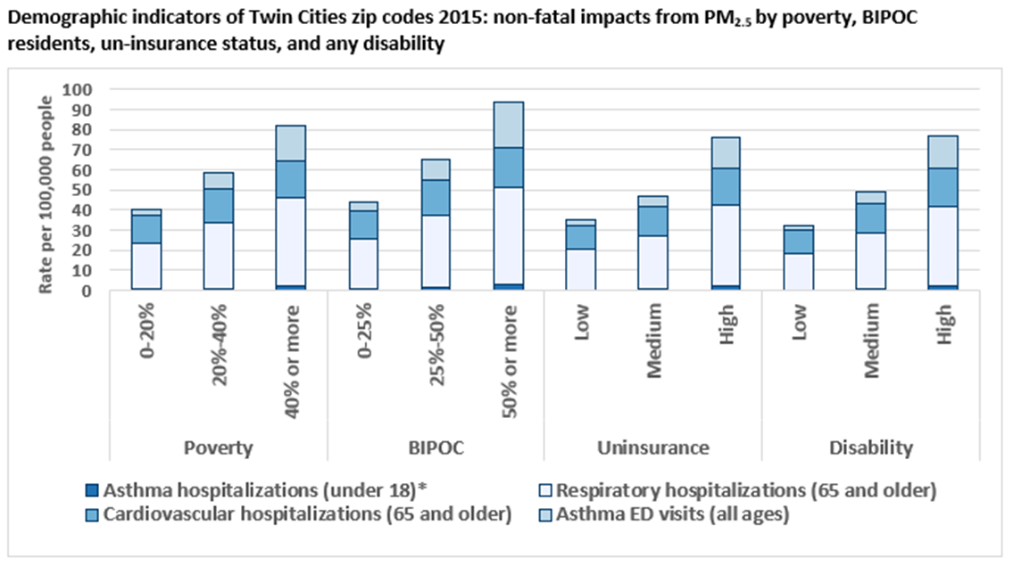
Metro findings
Overall, air pollution contributed to nearly 500 cardio-pulmonary hospitalizations during the project period.
Disparities in non-fatal outcomes follow similar pattern across communities with more BIPOC residents, more people living in poverty, with a disability, or without health insurance.
Areas with the highest proportion of BIPOC residents had more than five times the rate of asthma emergency room visits.
Notes:
There is an observable trend where the highest estimated rates of air pollution-related death and disease are found in neighborhoods with the largest percentage of Black, Indigenous and People of Color (BIPOC), low-income and uninsured residents, and people who live with a disability. For example, zip codes with the largest percentage of BIPOC residents had more than five times the rate of asthma emergency room visits related to air pollution compared to areas with more white residents.

Slide 12
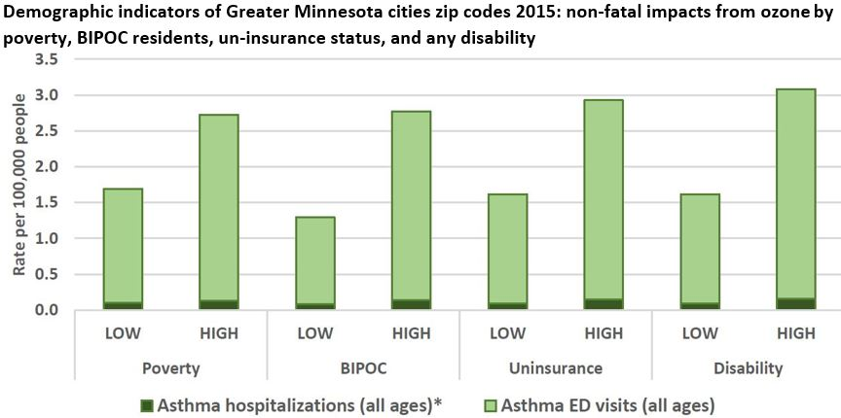
Greater Minnesota city findings
Despite relatively good air quality in Duluth, Rochester, and St. Cloud, we find health impacts from fine particles and ozone pollution.
Overall, air pollution contributed to around 50 hospitalizations and emergency department visits during the project period.
Similar pattern in disparities for asthma hospitalization and ED visits, compared to Metro.
Notes:
non-fatal but serious health impacts of air pollution vary across Greater Minnesota cities’ zip codes depending on poverty, BIPOC, uninsurance, and disability levels. This analysis shows rates of hospitalizations and emergency department visits attributable to ozone exhibit similar patterns for each of these demographic indicators. Areas with higher poverty, higher BIPOC populations, higher levels of uninsurance or higher disability rankings each show increasing attributable rates for every estimated health impact

Slide 13
Summary and action steps
Achieving health equity and environmental justice are linked
Wide and consistent health disparities across urban areas of the state
Underlying chronic health inequities may increase vulnerability to environmental pollution
Action is needed to improve outcomes together with communities
Reducing local air pollution further could avoid impacts
Continue inter-agency efforts and support of local agencies, partners, and communities to protect health of all Minnesotans
MPCA’s Life and Breath web page: https://www.pca.state.mn.us/air/life-and-breath-report
Minnesota Public Health Data Access portal: https://data.web.health.state.mn.us/web/mndata/life_and_breath
Notes:
Air pollution reduction is one way to address structural barriers to health
Reducing local air pollution further could avoid almost 200 premature deaths, based on this simulation

Slide 14
Thank you!
Questions?
MDH – Kathy Raleigh, Kathy.Raleigh@state.mn.us
MPCA-David Bael, David.Bael@state.mn.us

